Slide 1
Improving the Scalability and Realism of Game-Theoretic Approaches for Baseball
Spencer Armon

Slide 2
Background
Model baseball as a zero-sum stochastic game: lineup v pitcher
Designed with real MLB game data from 2008-2024
Use cases:
pitcher and hitter strategy
lineup optimization
hitter/pitcher substitution
trade targets
First, must make model accurate and scalable

Slide 3
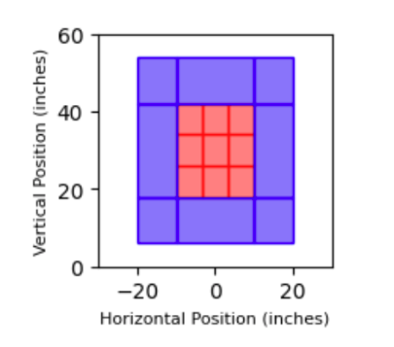
The Model
State: inning, outs, batter, balls, strikes, baserunners
Pitcher chooses pitch type (6) and intended zone (17)
Batter chooses to hit or take
Pitcher represented by speed and frequency across zone/pitch
Batter represented by average and swing frequency across zone/pitch

Slide 4
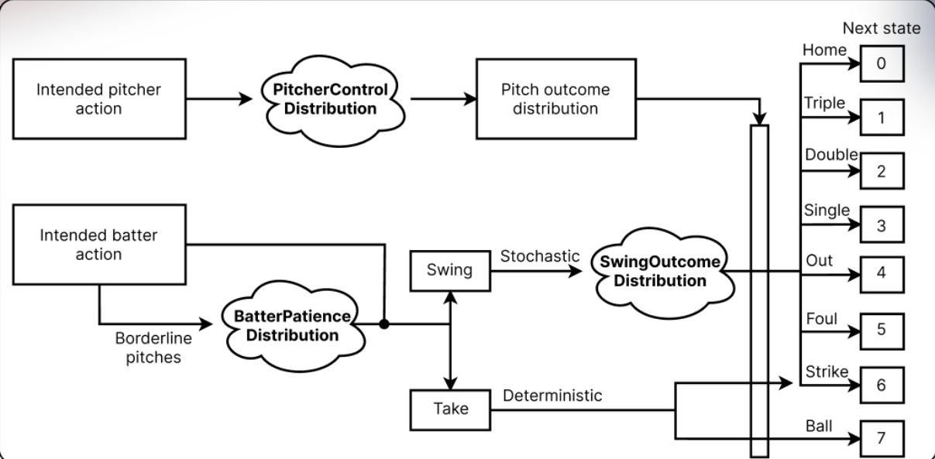
Calculation
Convolutional ML Distributions
Pitcher control
Batter patience
Swing outcome
Calculate transition distribution
Calculating strategy using value iteration, then calculate ERA

Slide 5
My Role
Binyamin Friedman made good model (also mentored by Dr. Vorobeychik)
My goal was to improve accuracy and scalability
Model took a long time to run
Debug rules
Aaron Nola’s calculated ERA vs. Cardinals (5.13) well above career ERA (3.70)
My contributions
Stochastic runners
ERA computation
Enhancing batter representation

Slide 6
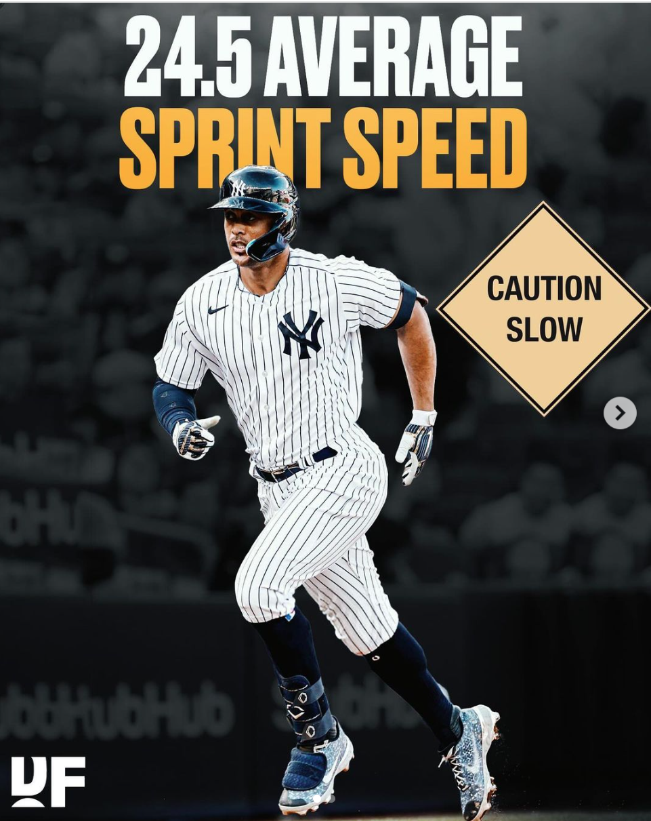
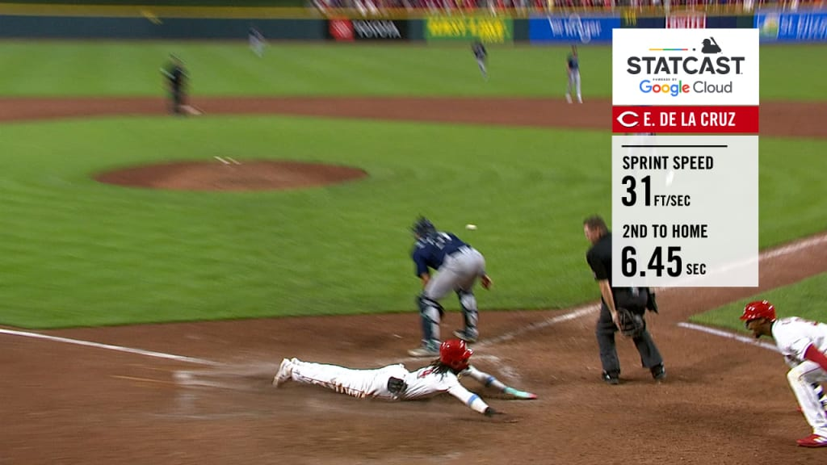
Runners
In the initial model, singles advanced runners one base and doubles advanced runners two bases
Runners frequently advance more than the batter
Doesn’t differentiate between slow and fast runners

Slide 7
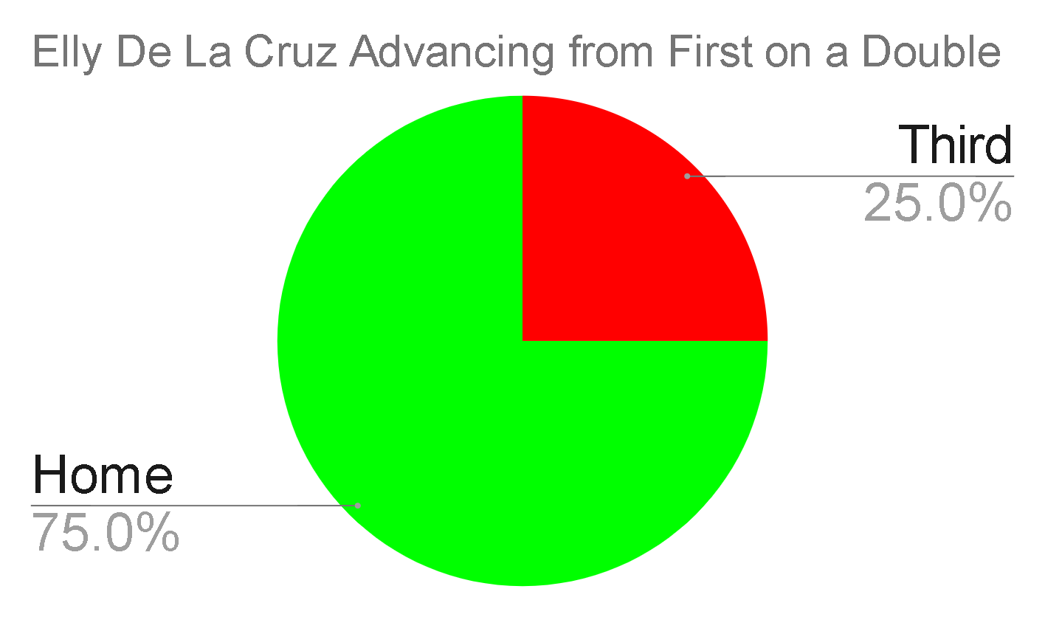
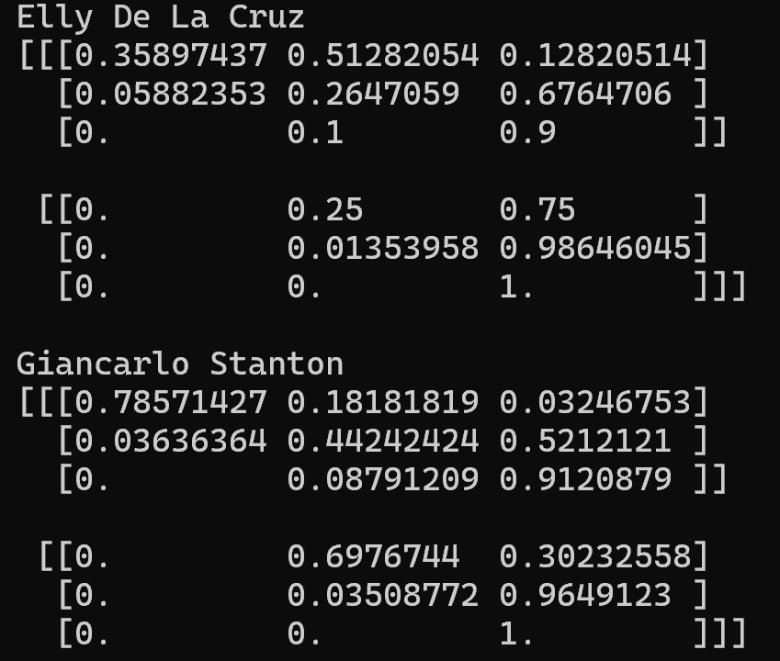
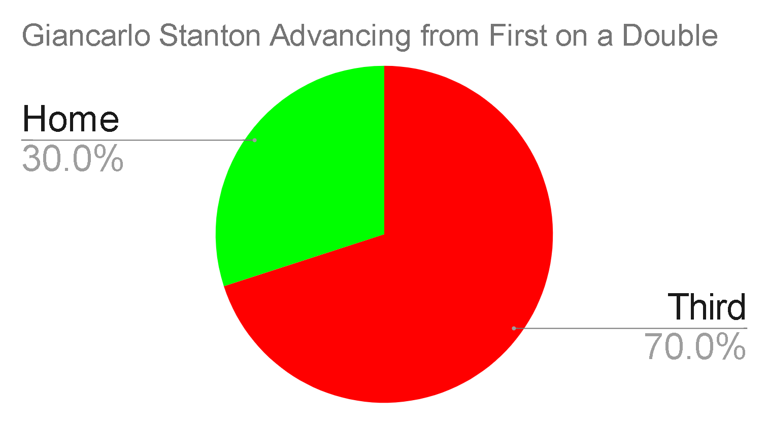
Stochastic Runners Solution
Runner data stores 2x3x3 tensor: hit type, starting base, ending base
Much better than before!

Slide 8
ERA Computation
To calculate ERA initially, find transitions and values for states in all 9 innings
Inefficient
Strategy is to maximize/minimize runs, independent of inning
Strategy has minimal changes
Only calculate values and transitions for single inning
How to extend to 9 innings?
Can’t just multiply by 9
Solution: calculate inning results with each batter starting the inning (run and probability of each batter beginning the next inning)

Slide 9
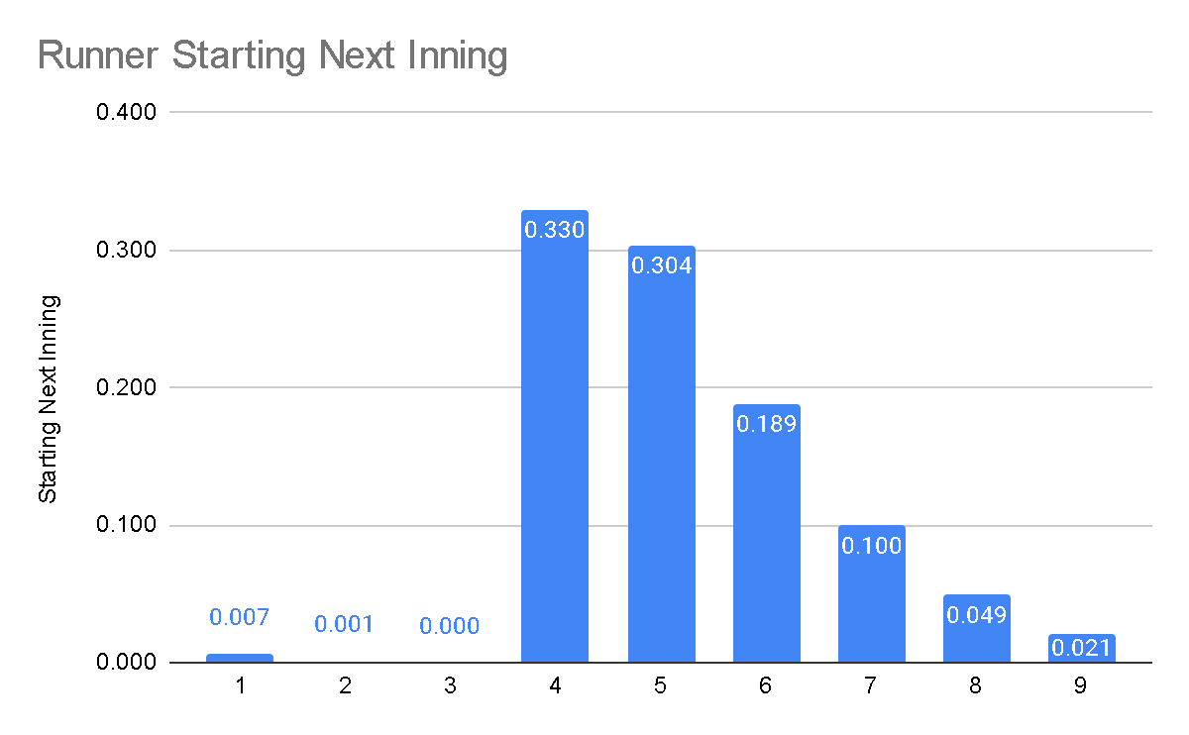
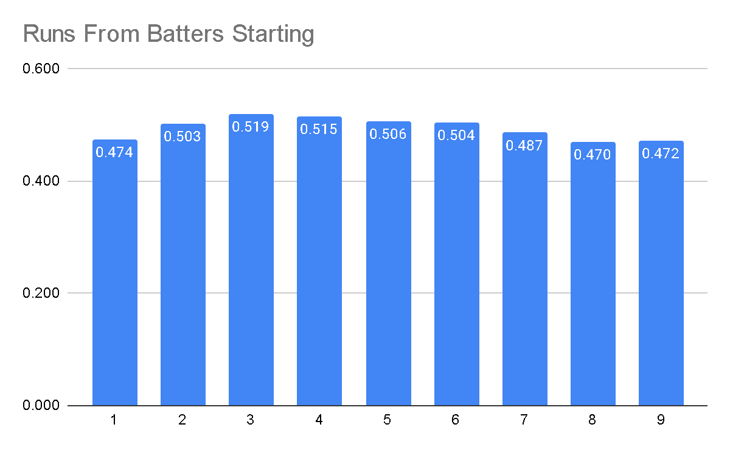
ERA Example with Cardinals Lineup: First 2 Innings
Winn, Burleson, Contreras, Goldschmidt, Donovan, Arenado, Nootbaar, Carpenter, Gorman
Expected number of runs in first inning: 0.474
0.474 + dot product = 0.978 runs in the first two innings

Slide 10
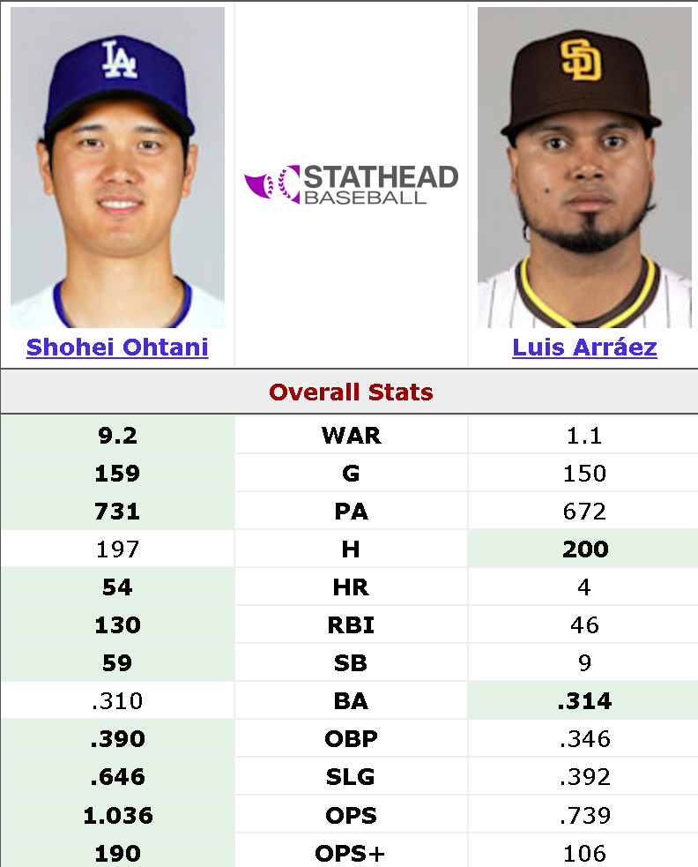
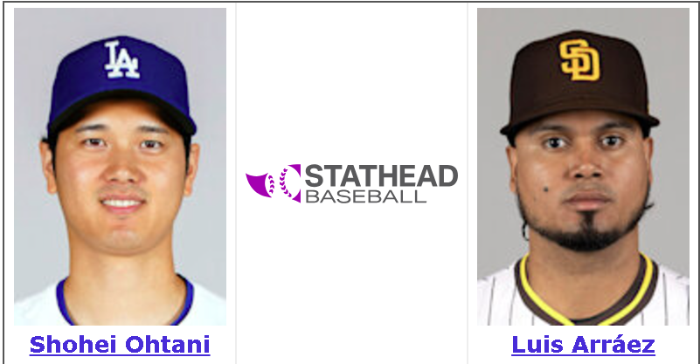
Enhancing Batter Representation
To predict swing outcome, convolutional neural network takes in batter and pitcher representation as well as pitch type/location
Pitcher representation: frequency and speed for each pitch type/location
Batter representation: frequency and batting average for each pitch type/location
Swing outcome predicts hit type, how to predict that only with average?
Ohtani vs Arraez: 9.2 vs 1.0 in WAR in 2024
Arraez had more singles, Ohtani had more doubles, triples, homeruns

Slide 11
Slugging Percentage
Number of bases per at bat
SLG with AVG gives better overall representation of batter
4-seam fastballs down the middle
Swing outcome neural network cross entropy loss fell from 1.341 to 1.339
Marginal improvement
1.945 is uniform guessing
Hard to be accurate with this dataset
 | Ohtani | Arraez
AVG | 0.308 | 0.276
SLG | 0.774 | 0.299

Slide 12
Takeaways
Successfully improved scalability and accuracy of model
Aaron Nola ERA vs Cardinals went from 5.1 to 4.4 (closer to his 3.7 career ERA)
Runners
Slugging
Debug rules
Sped up 8x
Model is ready for future applications
Challenging but meaningful learning experience
Complex codebase
Unfamiliar disciplines
First research experience
Thank you Dr. Vorobeychik for your guidance, knowledge, and patience

